Slide 1

Data Analysis Essentials
Cornerstone Project — Second Review
Movie Rating Analysis System
Batch - 7
Presented by
M. Bhagya Sri (25B11AI720)
B. Jyostnavi (25B11AI081)
N. Swathi (26B21AI081)
K. Sri Bhargavi(26B21AI050)
Department of Artificial Intelligence & Machine Learning
Under esteemed guidance of:
Mr.B.Sai Venkata Ganesh
M.Tech, Assistant Professor (AIML)

Slide 2




PRESENTATION OVERVIEW
Problem: Analyze a Netflix titles dataset to identify content types, release-year patterns, ratings, countries, and genres.
Objective: Clean the Netflix data, explore its structure, analyze important patterns, visualize the results, and generate useful insights.
Domain: Entertainment / Media
Dataset Used: Netflix Titles dataset containing 8,812 records and 12 columns.
Tools: Python, Pandas, NumPy, Matplotlib, Google Colab

Slide 3
DATASET SNAPSHOT
Dataset contains information about:
Movies and TV Shows
Directors and Cast
Countries
Release Years
Ratings
Duration
Genres
Descriptions
CHECK | BEFORE CLEANING | AFTER CLEANING
Rows | 8812 | 8807
Columns | 12 | 12
Missing Values | 4314 | 0
Duplicate rows | 5 | 0

Slide 4
DATA LOADING
#IMPORT LIBRARIES
import pandas as pd
import numpy as np
#DATA LOADING
from google.colab import files
uploaded = files.upload()
file_name = list(uploaded.keys())[0]
df = pd.read_csv(file_name)
print("Dataset loaded successfully")
CODE :
OUTPUT :
The dataset is uploaded directly into Google Colab and loaded into a Pandas DataFrame. The DataFrame df is used for further exploration, cleaning, preprocessing, and analysis.
EXPLANATION :

Slide 5
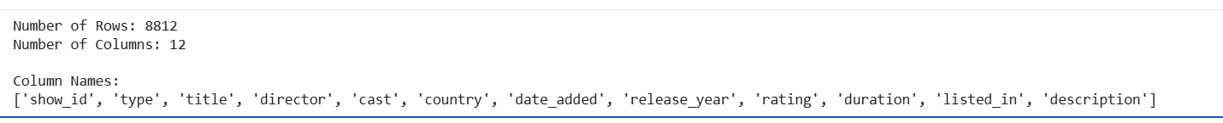
DATA UNDERSTANDING
# Data Understanding
print("Number of Rows:", df.shape[0])
print("Number of Columns:", df.shape[1])
print("\nColumn Names:")
print(df.columns.tolist())
CODE :
OUTPUT :
Data understanding helps us identify the size and structure of the Netflix dataset before performing cleaning and analysis.
EXPLANATION :

Slide 6
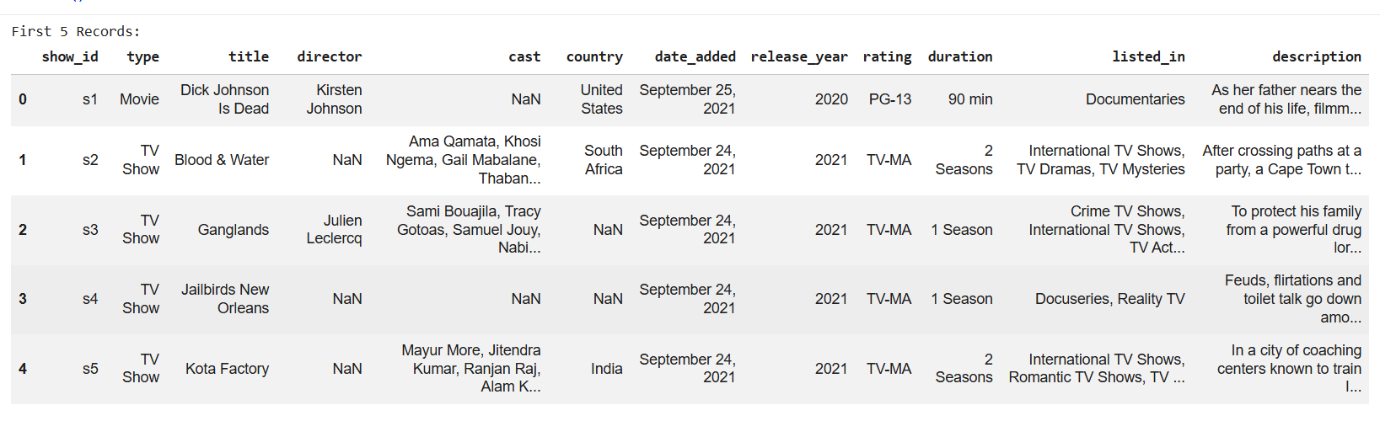
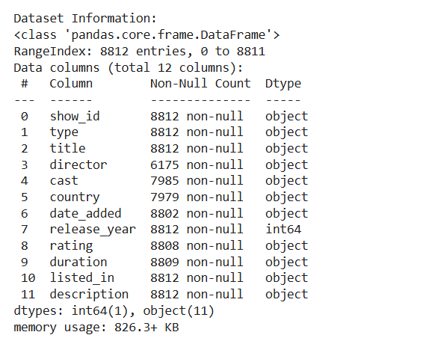
DATA INSPECTION
# Data Inspection
print("First 5 Records:")
display(df.head())
print("\nDataset Information:")
df.info()
OPERATIONS:
head() → displays the first 5 records
info() → shows column names, data types, and non-null values
CODE :
OUTPUT :

Slide 7
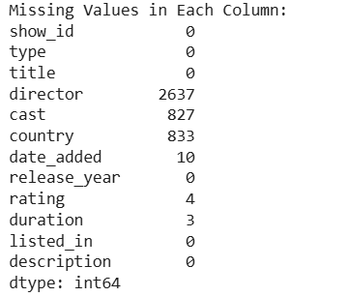
MISSING VALUE ANALYSIS
# Missing Value Analysis
missing_values = df.isnull().sum()
print("Missing Values in Each Column:")
print(missing_values)
IMPORTANT FINDINGS:
Total missing values: 4,314
CODE :
OUTPUT :
Missing values were identified before cleaning so that they could be handled appropriately during the data-cleaning stage.
EXPLANATION :

Slide 8

DUPLICATE VALUE ANALYSIS
# Duplicate Value Analysis
duplicate_count = df.duplicated().sum()
print("Number of Duplicate Rows:", duplicate_count)
CODE :
OUTPUT :
Five completely duplicated records were identified in the dataset. These duplicate rows were removed before further analysis.
EXPLANATION :

Slide 9


DATA CLEANING
# Remove Duplicate Rows
df = df.drop_duplicates()
print("Duplicate rows removed successfully")
print("Number of Duplicate Rows:", df.duplicated().sum())
print("Updated Dataset Shape:", df.shape)
#Handle Missing Values
df['director'] = df['director'].fillna('Unknown')
df['cast'] = df['cast'].fillna('Unknown')
df['country'] = df['country'].fillna('Unknown')
df['date_added’] =df['date_added'].fillna('Unknown')
df['rating'] = df['rating'].fillna('Unknown')
df['duration'] = df['duration'].fillna('Unknown')
print("Missing values handled successfully")
print("\nMissing Values After Cleaning:")
print(df.isnull().sum().sum())
CODE :
OUTPUT :
Duplicate rows removed: 5
Final row count: 8,807
Missing values were handled using "Unknown".
RESULT :

Slide 10
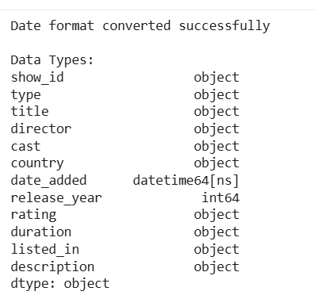
DATA PREPROCESSING
# Data Preprocessing
df['date_added'] = pd.to_datetime(
df['date_added'],
errors='coerce’)
print("Date format converted successfully")
print("\nData Types:")
print(df.dtypes)
CODE :
OUTPUT :
The date_added column was converted into a proper date format. This makes the column suitable for future date-based analysis.
EXPLANATION :

Slide 11
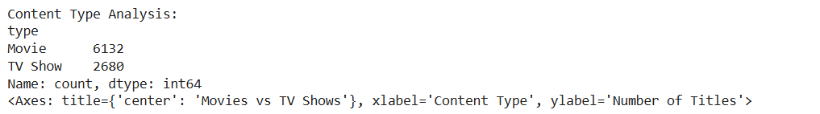
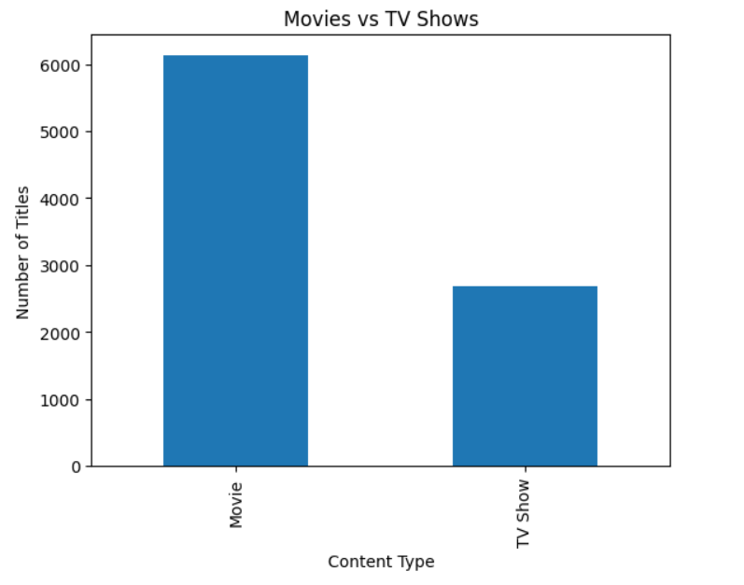
DATA ANALYSIS
# Data Analysis - Movies vs TV Shows
type_count = df['type'].value_counts()
print("Content Type Analysis:")
print(type_count)
type_count.plot( kind='bar', title='Movies vs TV Shows', xlabel='Content Type', ylabel='Number of Titles' )
CODE :
OUTPUT :

Slide 12
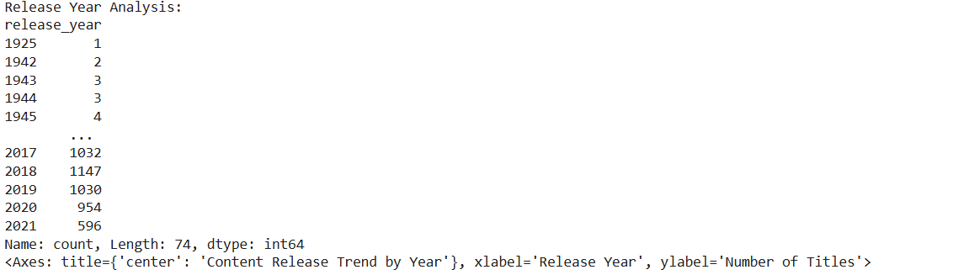
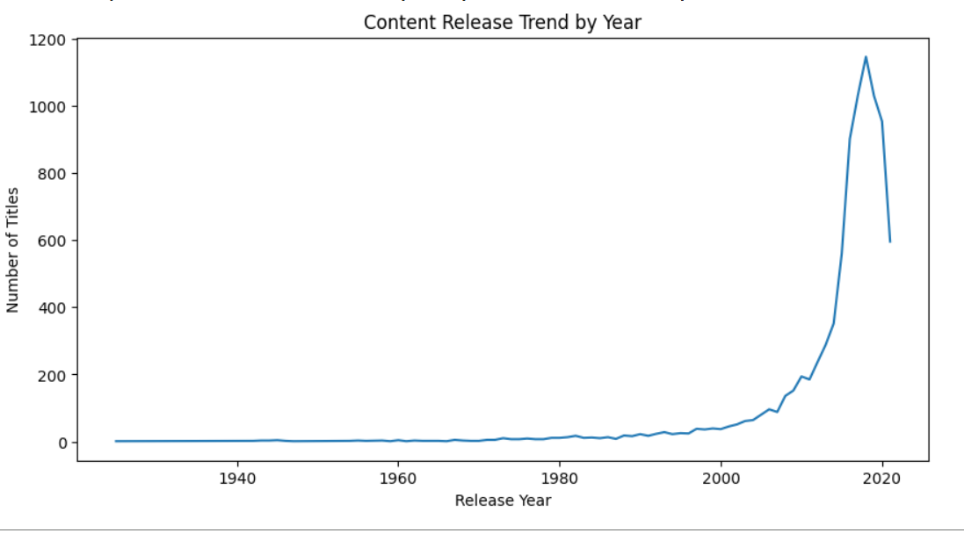
RELEASE YEAR ANALYSIS
# Data Analysis - Release Year Analysis
release_year_count = df['release_year'].value_counts().sort_index()
print("Release Year Analysis:")
print(release_year_count)
release_year_count.plot(
kind='line',
title='Content Release Trend by Year',
xlabel='Release Year',
ylabel='Number of Titles',
figsize=(10, 5))
CODE :
OUTPUT :

Slide 13
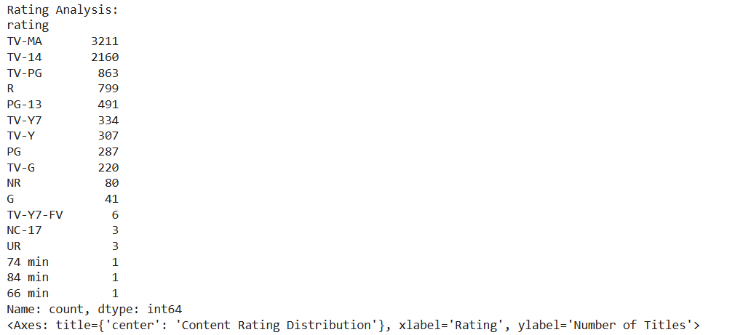
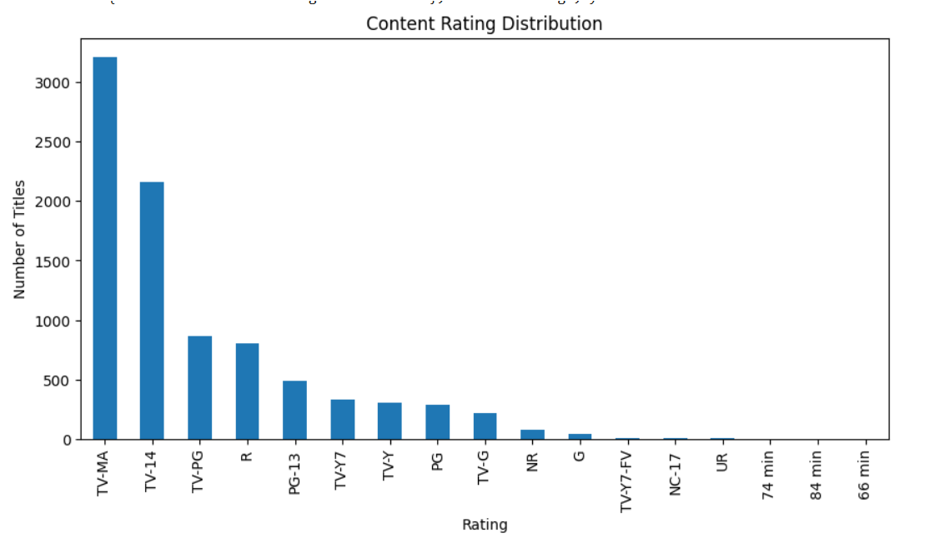
RATING ANALYSIS
# Data Analysis - Rating Analysis
rating_count = df['rating'].value_counts()
print("Rating Analysis:")
print(rating_count)
rating_count.plot(
kind='bar',
title='Content Rating Distribution',
xlabel='Rating',
ylabel='Number of Titles',
figsize=(10, 5))
CODE :
OUTPUT :

Slide 14
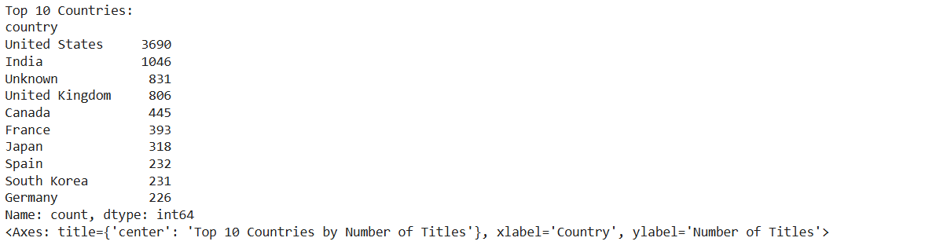
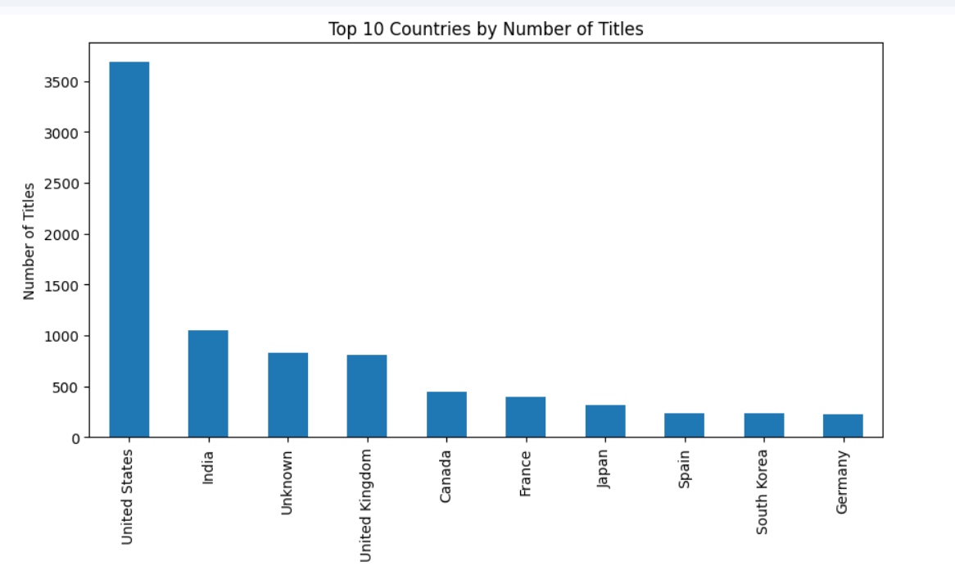
DATA UNDERSTANDING
# Data Analysis - Top 10 Countries
country_count = (
df['country']
.str.split(',')
.explode()
.str.strip()
.value_counts())
print("Top 10 Countries:")
print(country_count.head(10))
country_count.head(10).plot(
kind='bar',
title='Top 10 Countries by Number of Titles',
xlabel='Country',
ylabel='Number of Titles',
figsize=(10, 5))
CODE :
OUTPUT :

Slide 15
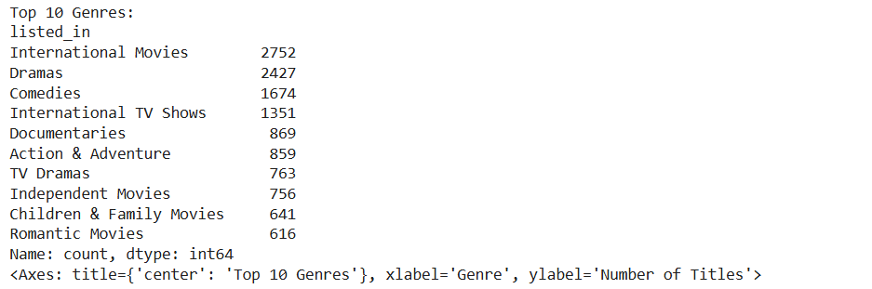
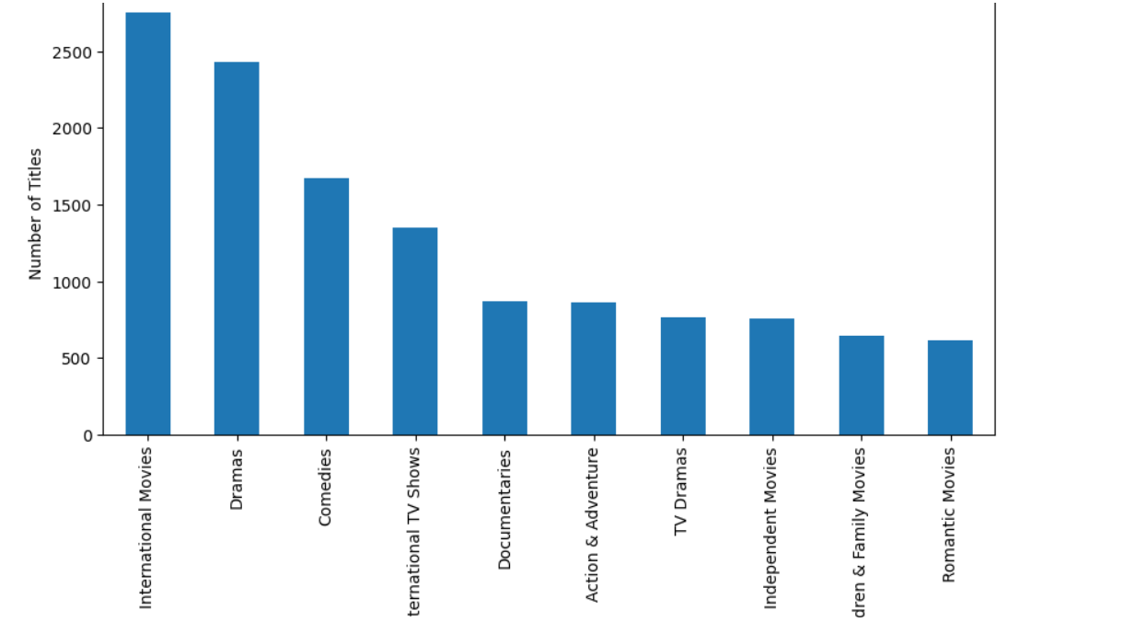
DATA UNDERSTANDING
# Data Analysis - Top 10 Genres
genre_count = (
df['listed_in']
.str.split(',')
.explode()
.str.strip()
.value_counts())
print("Top 10 Genres:")
print(genre_count.head(10))
genre_count.head(10).plot(
kind='bar',
title='Top 10 Genres',
xlabel='Genre',
ylabel='Number of Titles',
figsize=(10, 5))
CODE :
OUTPUT :

Slide 16
RESULTS
Main Findings
8,807
Cleaned Netflix records
12
Dataset columns
5
Duplicate rows removed
4,314
Missing values identified before cleaning
Movies & TV Shows
Content types analyzed
Release Years
Year-wise content trends analyzed
Ratings
Rating distribution analyzed
Countries & Genres
Top categories identified through analysis

Slide 17
COMPLETED PROJECT WORKFLOW
RAW DATASET
↓
DATA LOADING
↓
DATA UNDERSTANDING
↓
DATA INSPECTION
↓
MISSING VALUE ANALYSIS
↓
DUPLICATE ANALYSIS
↓
DATA CLEANING
↓
DATA PREPROCESSING
↓
DATA ANALYSIS
↓
RESULTS

Slide 18
CONCLUSION
The Netflix Movie Rating Analysis System demonstrates a complete data analysis workflow using Python, Pandas, NumPy, and Matplotlib.
The Netflix dataset was successfully loaded and inspected.
Missing values were identified and handled.
Five duplicate rows were identified and removed.
Data preprocessing was performed to prepare the dataset for analysis.
Content type, release year, rating, country, and genre analyses were performed.
Graphs were created to visualize important patterns.
The cleaned dataset was prepared for further analysis.

Slide 19
TEAM CONTRIBUTION
M.BHAGYA SRI(25B11AI720)
Responsible for code implementation, dataset loading, data exploration, and preprocessing. Also handled the project code execution and screen sharing during the presentation.
B . JYOTSNAVI (25B11AI081)
Worked on dataset collection and preparation. Contributed to checking missing values, duplicate records, and overall data quality.
N . SWATHI (26B21AI081)
Worked on data analysis and calculations. Contributed to identifying movie counts, unique movie names, repeated movie names, and important results.
K . SRI BHARGAVI (26B21AI050)
Contributed to project analysis, PPT preparation, organizing project content, and presentation coordination. Also supported the team in reviewing the project outputs and arranging the content for the final review

Slide 20


